Slide 1
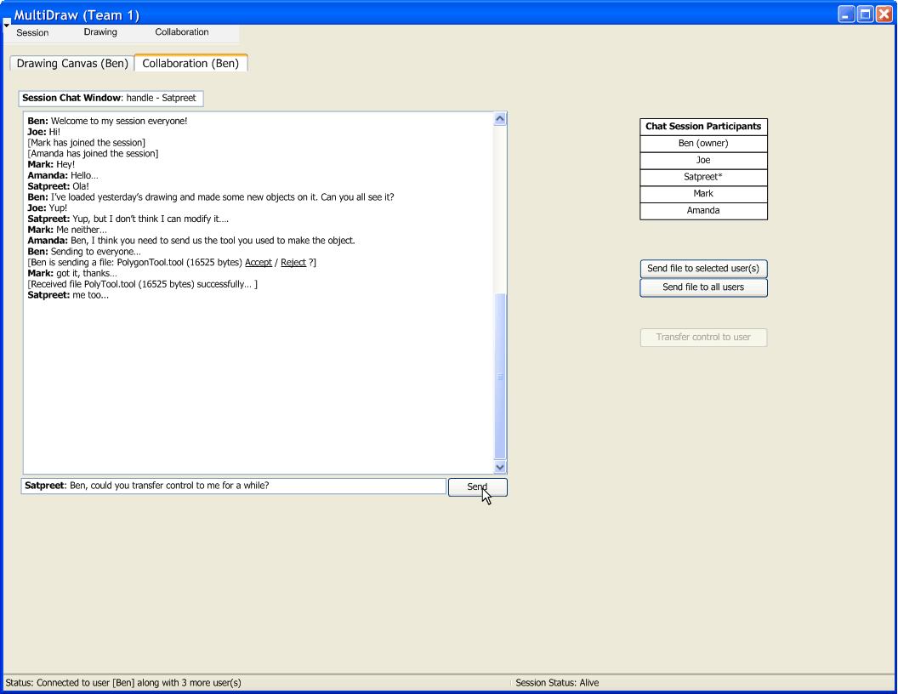

Slide 2
Iterations
Iteration 1:
  Understand underlying technology
  Connect to another peer; (use old GUI)
  Pass an object over network; Acknowledge reception of object in some way;
Iteration 2:
  Establish a hierarchy of objects sent over network
  Acknowledge reception and recognize object received
Iteration 3:
  Setup networking model (how we send/receive events, canvas, objects, etc.)
  Make new GUI supporting collaboration (…. continued)

Slide 3
Iterations
Iteration 3 (… continued):
  Make canvas receive a session “owner’s” canvas in real-time
  Display network object feedback on chat window (layered event feedback)
  (Optionally) Make P2P chat work
Iteration 4:
  Implement transfer of “ownership”
  Loading and saving session (canvas + objects)
  Dynamic tool loading
  Tool sending and receiving over network
  Network robustness/optimization

Slide 4
Process Model
Iterative , Incremental development
Incremental design with short stages is ideal for a month-long project
Establishes working builds at the end of each iteration
Build upon previous framework to expand scope
Conducive to teamwork, and modularization will be introduced in later iterations
  after the basic framework is established

Slide 5
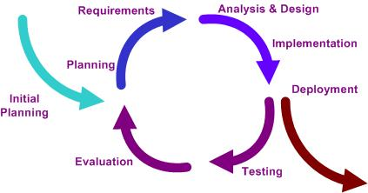
Cyclic development
Modifications will fit into simple modules
Each iteration should analyze goals and reassess iteration plans if necessary
Each iteration cycle has distinct phases with specific goals.

Slide 6
Development Plan-Config management
Primary plan is to use SVN, which served most of our subgroups well during first project.
Allows offline work, and is convenient to use.
Limited use of googledocs for some online meetings/live collaboration.

Slide 7
Development Plan-Responsibilities
Ben : Liaison, Architecture & Communication models, Implementer/tester
Joe: Technical documentation control, Implementer/tester
Amanda: Non-technical documentation control, Implementer/tester
Mark: Implementer/tester
Satpreet: Implementer/tester

Slide 8
Schedule
First Iteration (04/09-04/16):
Be able to deploy classes as web services
Load objects in the main program
Start a session
Second Iteration (04/16-04/23)
Save and call an object’s XML file representation
Peer-to-peer collaboration to share tools, objects
Dynamic object loading
Final iteration (04/23/09-05/06/09)
Multiple users can make requests
Save and resume a session

Slide 9
Risks
Assessed risks in terms of the probability of occurrence and the severity if realized
Divided these risks into severity categories
Brainstormed to create a list of possible risks that might impact the project at some point
  Ranging from code inefficiency problems to teamwork or deadline difficulties
  Example: Test is not conducted on a specific system component.

Slide 10
Risks
Each risk was then examined for a potential approach that would lessen its negative impact
Ex.
  Test correct component, but examine the incorrect data for possible accidental bug discovery.
  Have multiple testers with overlapping bug investigations.

Slide 11
Risk Examples
Insufficient time to realize each iteration fully
  Plan ahead to determine how much time may be spent on each iteration.
  Make iterations short with related tasks.
Unavailable team members at crucial times
  Contact information available
  Firm meeting plans established ahead of time
Requirement ambiguity
  Resolve ambiguities as a team in the planning phase
Missing final deadline
  Establish “soft deadlines” to ensure project is on par

